Slide 1
Testing From Beginner to Expert
ccao@ecvictor.com
ECV Learning

Slide 2
Presenter
Charles Cao,
Automation Team lead, Business Owner.10+ years working experience, He promoted to senior QA from an intern in only 3 years. Worked in IBM China, SAP, Autodesk, Expedia, Paysafe.

Slide 3
Agenda
Introduction: Path To an Great Quality Assurance Engineer
What is Quality Assurance
How to start as an Quality Assurance Engineer
When you are ready for a Testing job?

Slide 4
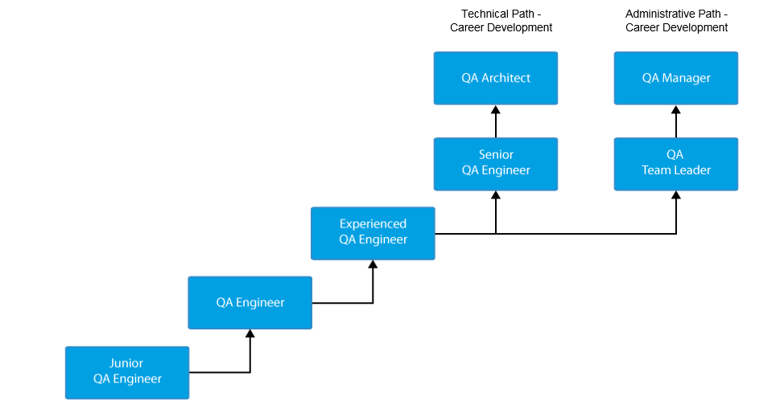
Path To an Great Quality Assurance Engineer

Slide 5
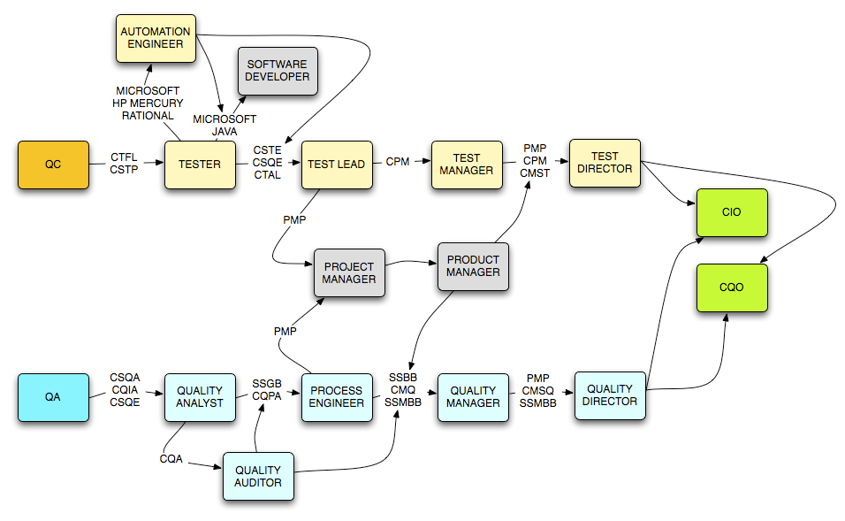
Path To an Great Quality Assurance Engineer

Slide 6
ECV Company Group
Service Ecvictor Inc.
ECV learning---Education
Product Group
Pinpin Eat
Thera technology
ECTD
Express Computing Inc.---Cropto currency mining
Nebula AI
AI computing
Blockchain
APIGM---- The IT Professionals Association of Greater Montreal

Slide 7
What is Quality Assurance
It is the process used to identify the correctness, completeness and quality of developed computer software.
It is the process of executing a program/application under positive and negative conditions by manual or automated means. It checks for the :-
Specification
Functionality
Performance

Slide 8
OBJECTIVES
Uncover as many as errors (or bugs) as possible in a given product.
Demonstrate a given software product matching its requirement specifications.
Validate the quality of a software testing using the minimum cost and efforts.
Generate high quality test cases, perform effective tests, and issue correct and helpful problem reports.

Slide 9
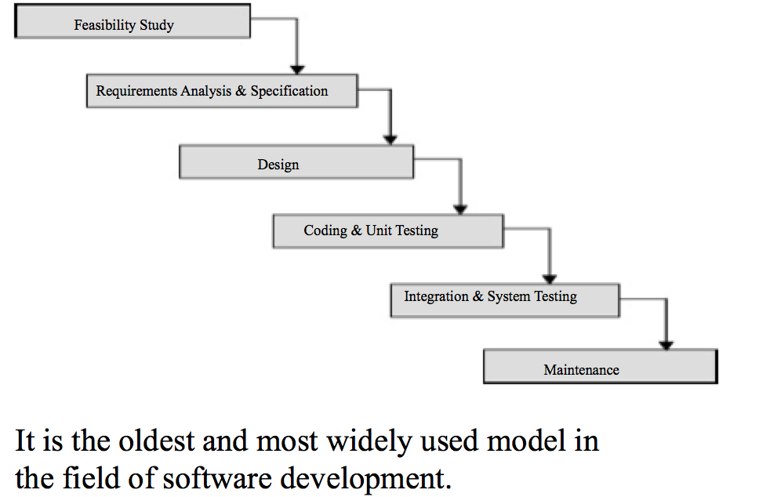
Classical Waterfall Model

Slide 10
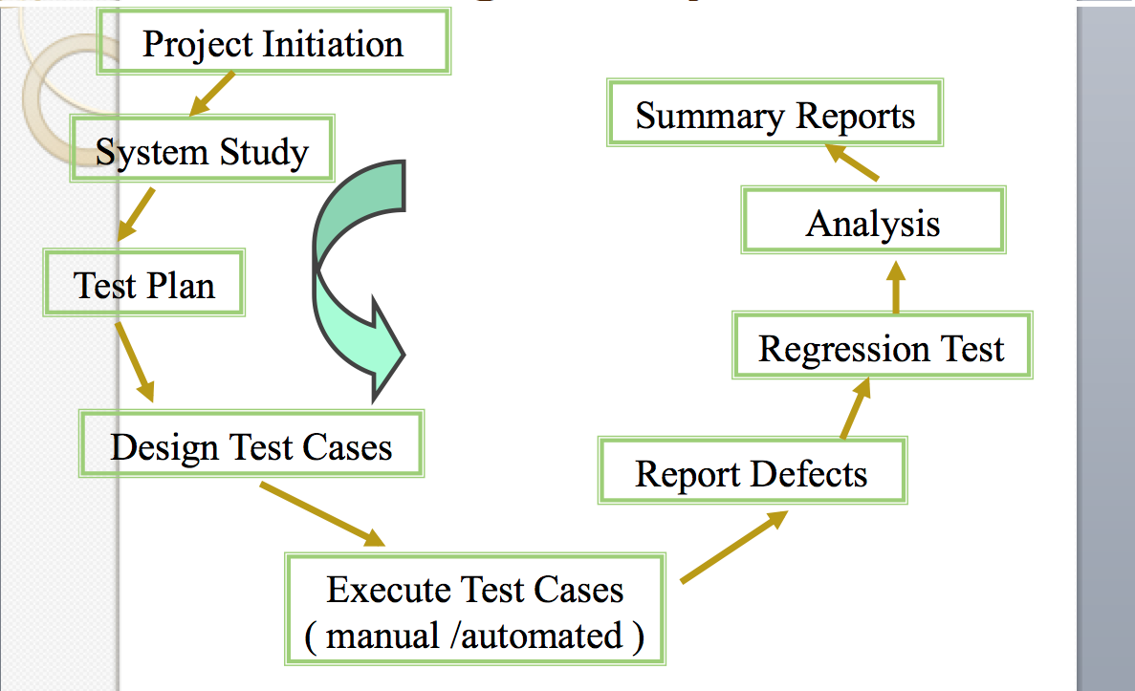
Testing Life Cycle

Slide 11
Testing Methodologies
Black box testing
No knowledge of internal program design or code required.
Tests are based on requirements and functionality.
White box testing
Knowledge of the internal program design and code required.
Tests are based on coverage of code statements, branches, paths, conditions.

Slide 12
Testing Type
Manual Testing
Automated Testing
Types of Software Testing – Complete List
http://www.testingexcellence.com/types-of-software-testing-complete-list/

Slide 13
Demo
Manual testing
GOOGLE page
Pinpin Market
Automation Testing
Selenium UI validating google
Pinpin Market online validation
Performance Test

Slide 14
Workshop Design
Web manual validation
Test case creation
Bug Reporting
Selenium IDE
Selenium Automation with Java
Cucumber Framework
Rest API Testing
Performance Testing

Slide 15
Test Plan
It is a systematic approach to test a system i.e. software. The plan typically contains a detailed understanding of what the eventual testing workflow will be.

Slide 16
Test Case
It is a specific procedure of testing a particular requirement.
It will include:
Identification of specific requirement tested
Test case success/failure criteria
Specific steps to execute test
Test data

Slide 17
Junit
A tool for test-driven development
@BeforeClass – Run once before any of the test methods in the class, public static void
@AfterClass – Run once after all the tests in the class have been run, public static void
@Before – Run before @Test, public void
@After – Run after @Test, public void
@Test – This is the test method to run, public void

Slide 18
Writing methods in TestCase
Pattern follows programming by contract paradigm:
Set up preconditions
Exercise functionality being tested
Check postconditions
Example:
public void testEmptyList() {
Bowl emptyBowl = new Bowl();
assertEquals(“Size of an empty list should be zero.”,
0, emptyList.size());
assertTrue(“An empty bowl should report empty.”, emptyBowl.isEmpty());
}
Things to notice:
Specific method signature – public void testWhatever()
Allows them to be found and collected automatically by JUnit
Coding follows pattern
Notice the assert-type calls…

Slide 19
Assert methods
assertTrue(String message, Boolean test)
assertFalse(String message, Boolean test)
assertNull(String message, Object object)
assertNotNull(String message, Object object)
assertEquals(String message, Object expected, Object actual) (uses equals method)
assertSame(String message, Object expected, Object actual) (uses == operator)
assertNotSame(String message, Object expected, Object actual)

Slide 20
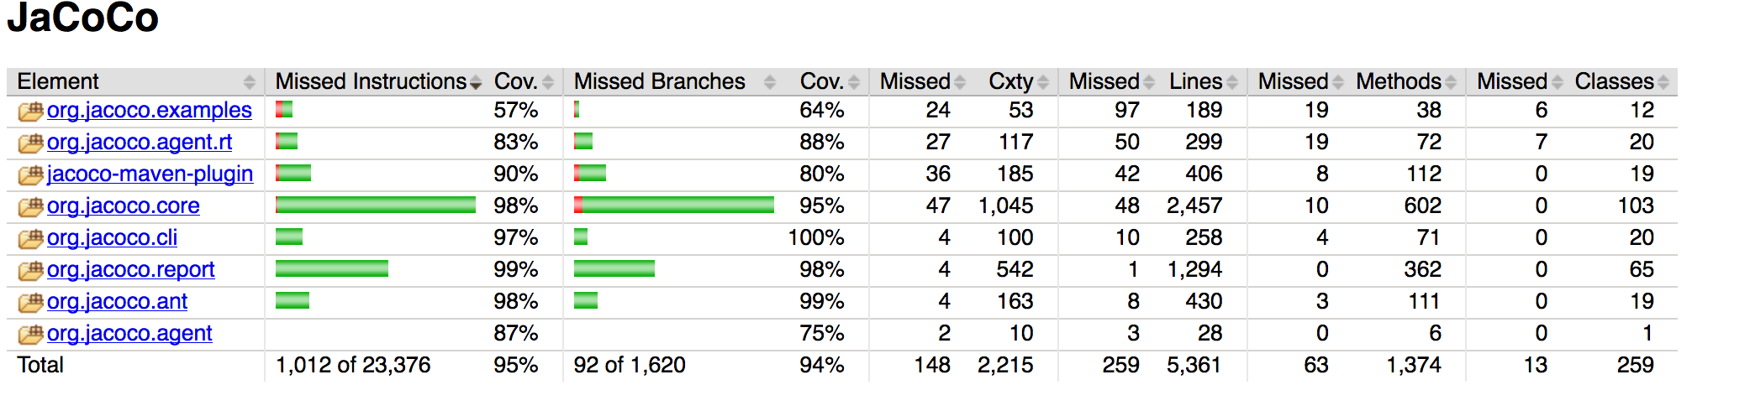
Code Coverage
EMMA
http://www.eclemma.org/jacoco/

Slide 21
Test Automation Using Selenium
Selenium IDE
Xpath
CSS selector
Demo

Slide 22
Selenium
Selenium is a robust set of tools that supports rapid development of test automation for web-based applications.
Selenium provides a rich set of testing functions specifically geared to the needs of testing of a web application.
Selenium operations are highly flexible, allowing many options for locating UI elements and comparing expected test results against actual application behavior.

Slide 23
Selenium Features
Supports Cross Browser Testing. The Selenium tests can be run on multiple browsers.
Allows scripting in several languages like Java, C#, PHP and Python.
Assertion statements provide an efficient way of comparing expected and actual results.
Inbuilt reporting mechanism.

Slide 24
Selenium IDE
Selenium IDE is an integrated development environment for Selenium tests.
It is implemented as a Firefox extension, and allows you to record, edit, and replay the test in firefox
Selenium IDE allows you to save tests as HTML, Java, Ruby scripts, or any other format
It allows you to automatically add assertions to all the pages.
https://addons.mozilla.org/en-US/firefox/addon/selenium-ide/
firebug

Slide 25
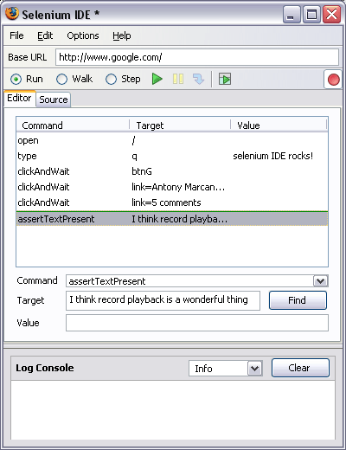
Selenium IDE - UI
Start and Stop
Recording
Replay
Toolbar
Selenese
Script
Editor
Accessor
Area
Selenium Log

Slide 26
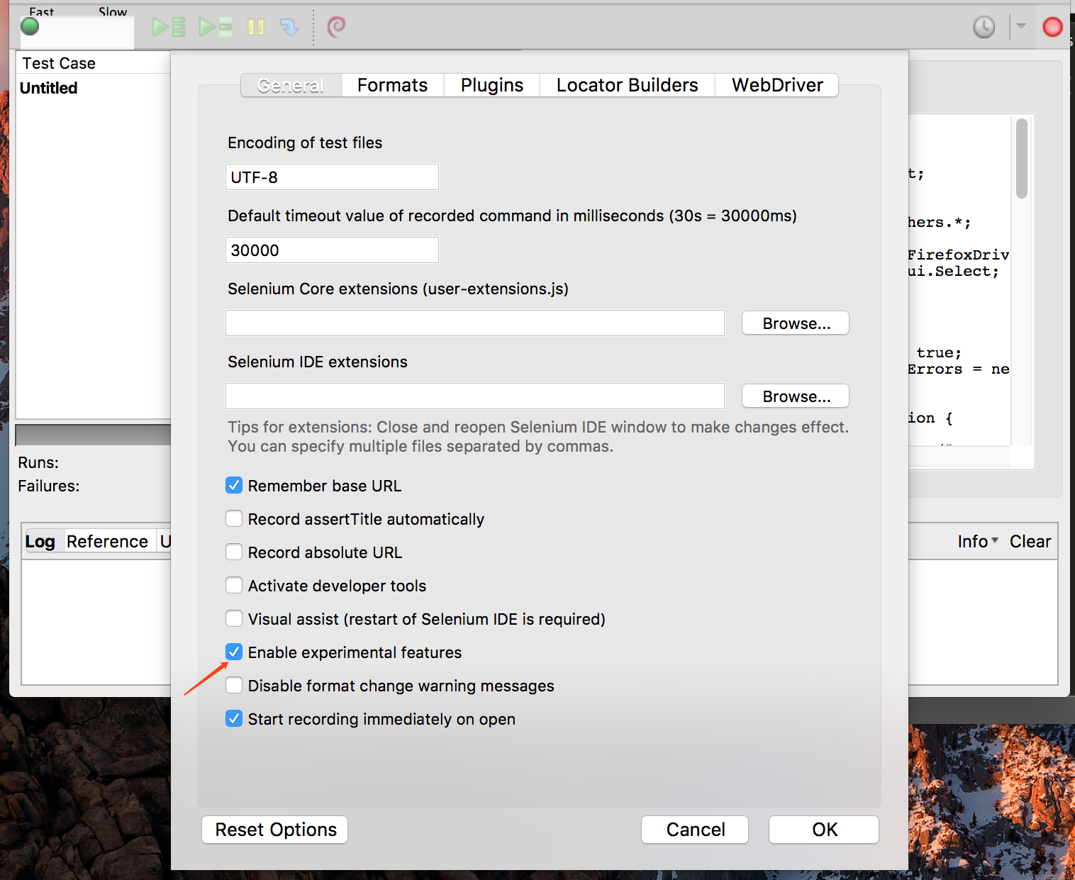
Add auto generate code

Slide 27
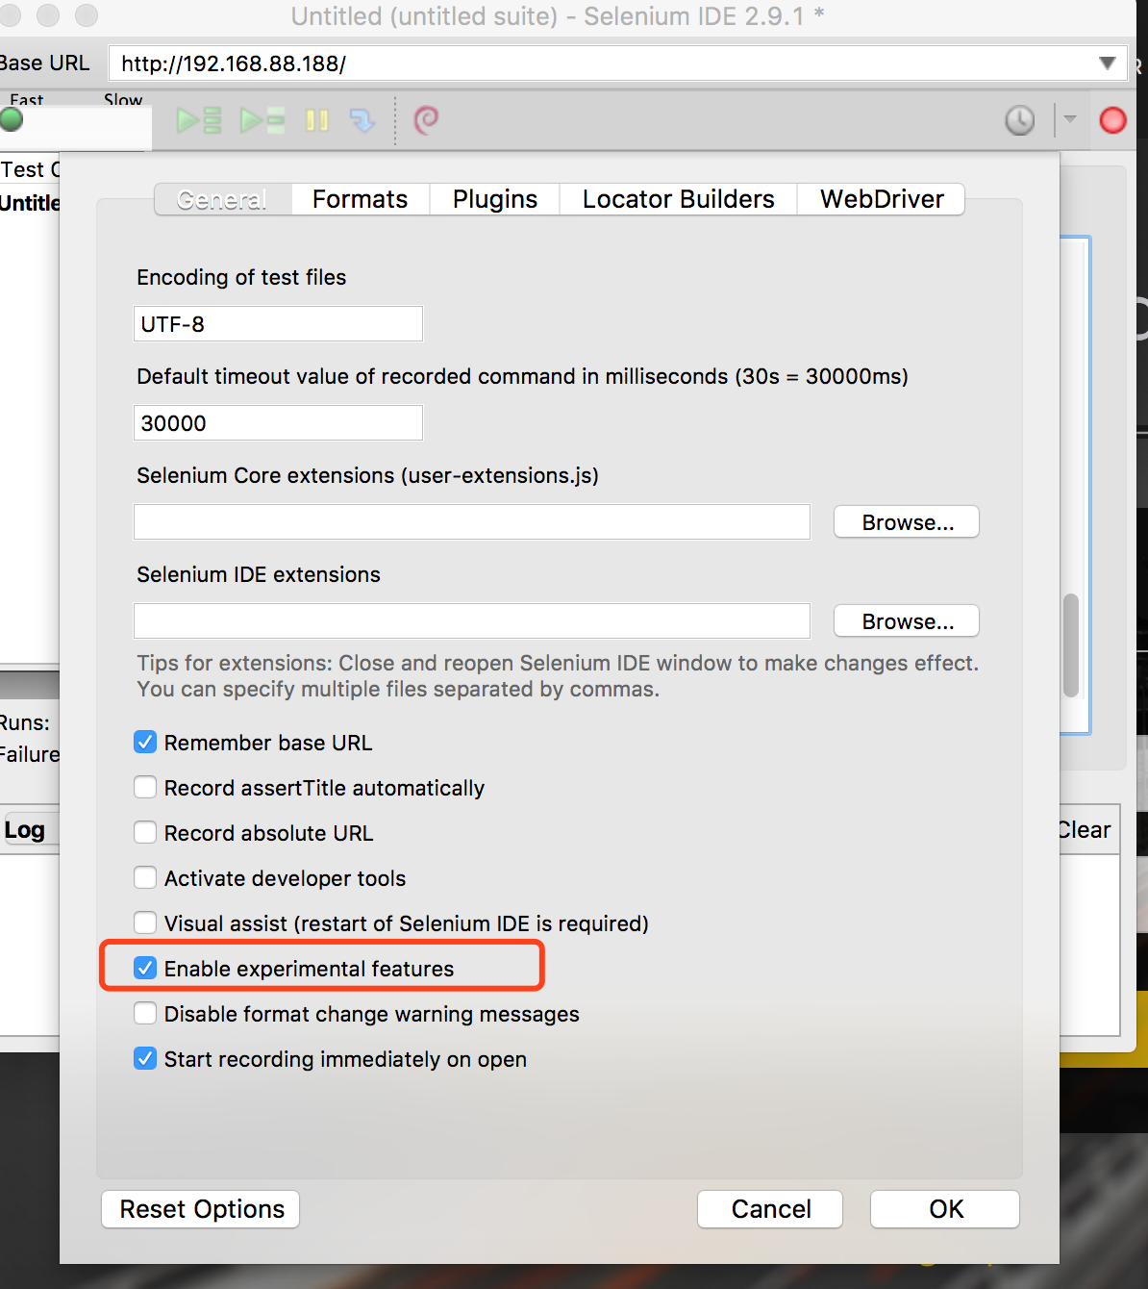
Selenium Recording

Slide 28
XPath in Selenium
http://www.guru99.com/xpath-selenium.html

Slide 29
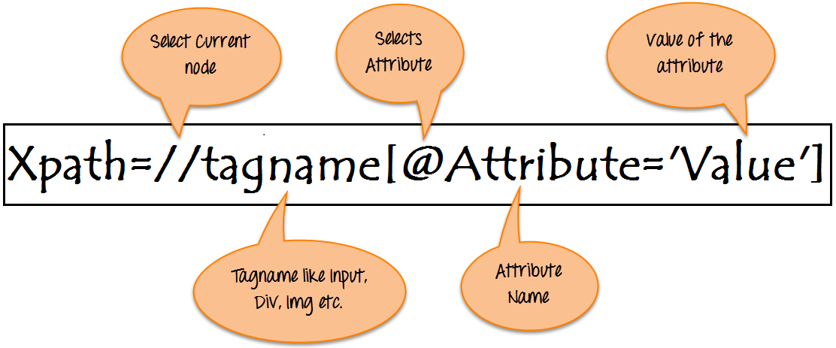
What is XPath

Slide 30
Xpath=//tagname[@attribute='value']
// : Select current node.
Tagname: Tagname of the particular node.
@: Select attribute.
Attribute: Attribute name of the node.
Value: Value of the attribute.

Slide 31
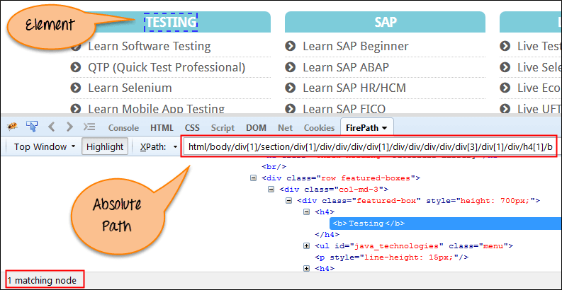
Absolute xpath:

Slide 32
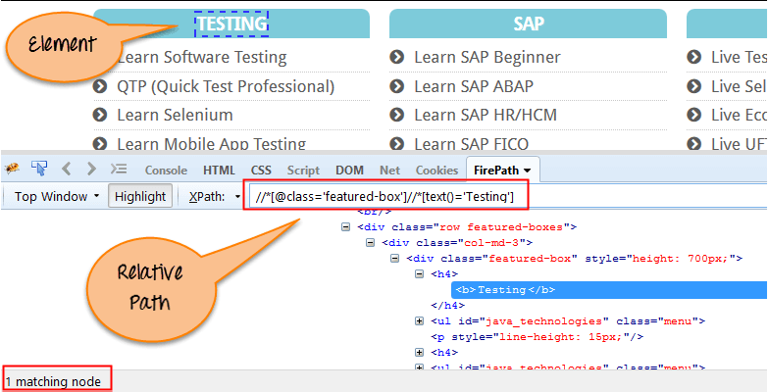
Relative xpath:

Slide 33
CSS Selector
https://www.w3schools.com/cssref/trysel.asp
https://saucelabs.com/resources/articles/selenium-tips-css-selectors
http://toolsqa.com/cucumber/data-driven-testing-using-examples-keyword/

Slide 34
UI Testing Design
Test Plan
Test case(Manual/Automation)
Pre condition
Testing steps
Validation
Post condition
Manual Testing
Automated Testing
Manual Testing
Converting to Automated test cases

Slide 35
Test design: IGA
Test plan
Scope: Desktop only, chrome
Enviroment: QA environment
Smoke Test
Open home page
My account page

Slide 36
IGA Test plan (Part II)
UAT Test
Login
Product detail
Place order
Payment
Regression Test:
Home page test suite
Top Bar Test
Navigator Test
Promotions
RECIPES
Footer
User Account suite
Login /logout
Signup

Slide 37
Page Object Pattern
Adds a layer of abstraction into your code.
Helps to organize your code once it grows large.
All automation is automatically reusable and shareable.
A way to separate tests from re-usable functions.
A way to store information about how the system works.

Slide 38
A way to specify what page functions start on, and what page they end on.
A way to programmatically break your tests when functionality changes.
Makes code maintenance easier.
There is even a PageFactory class available to automatically create them

Slide 39
How does it work?
Each page is defined as it’s own class.
Actions (including navigation) are represented as functions for a class.
Each function returns a new Page object, signifying what page the actions stops on.
Your tests “know” what page you are on, and will only give you access to functions available to that class.
Tests only talk to the page objects.
Page objects only talk to the driver.

Slide 40
Elements on the page are stored as variables for the page object.
Automatic page validations can be stored in the constructor for each page object.
Tests become a string of well defined functions, not meaningless gibberish.
Tests can be grouped by namespace.
Class Inheritance can be used to define functionality to a set of pages.
We can make functional logic transparent to the tests by returning different inherited classes.

